Slide 1
Modern Data Estate & Advanced Analytics
Sashank Pappu
Azure Data & AI Specialist

Slide 2


Sashank Pappu
Azure Data & AI Specialist.
Certified from MIT on ‘Advanced Analytics and Big Data Challenges’. Technology Enthusiast and Data Specialist. Certified Designer in Computer Vision
• Microsoft Certified Azure Data Architect. • Microsoft Certified Azure Machine Learning Developer • Certified on Practical Data Analytics with Microsoft Cortana Intelligence Suite.
10+ years of total experience as Data Specialist and Data Engineer.
Certifications
Experience
Currently working as Data Consultant on Azure Data & AI and Enterprise Trainer on Azure Data Analytics , Intelligence Suite and Cognitive Sciences
Expert facilitator and corporate behavioral trainer with 7 years of experience in designing programs, content development , Data Analytics and Machine Learning.
Role
Training
Sri Nag Sashank
Co-Founder & CTO – antz.ai

Slide 3




The session will span for 5 days & it is mandatory to attend all the days.
The audience will need to complete a hands-on lab challenge after day 5.
A proctor will be available to take your queries via “Chat” window. Kindly “MUTE” and do not disturb the presenter.
Note: More trainings on the same & similar topics would be delivered in near future. Keep your options open.
Guidelines for the event

Slide 4
What we will learn
Day | Topics
Day 1 | Explore, transform, and load data into the Data Warehouse using Apache Spark
Day 2 | Azure Databricks & Delta Lake Streaming
Day 3 | Transform data with Azure Data Flows or Azure Synapse Pipelines
Day 4 | Integrate data from notebooks with Azure Data Factory or Azure Synapse Pipelines Build reports using Power BI integration with Azure Synapse Analytics
Day 5 | End-to-end security with Azure Synapse Analytics
Challenge | End-to-End data analytics solution using Azure Synapse Analytics

Slide 5

To be more specific
What we will learn in next 5 days

Slide 6
Day 1 - Outcome
Perform
Perform Data Exploration in Synapse Studio
Ingest
Ingest data with Spark notebooks in Azure Synapse Analytics
Transform
Transform data with DataFrames in Spark pools in Azure Synapse Analytics
Integrate
Integrate SQL and Spark pools in Azure Synapse Analytics

Slide 7





Day 2 - Outcome
Understand Databricks & Delta Lake
Hands-On Delta Lake Architecture
Central Delta Lake
Delta Lake Zones Creation.
Streaming Data Management.

Slide 8
Day 3-Outcome
1
2
3
Execute code-free transformations at scale with Azure Synapse Pipelines
Create data pipeline to import poorly formatted CSV files
Create Mapping Data Flows

Slide 9
Day 4-Outcome
Data movement in Azure Synapse Pipelines
Transformation in Azure Synapse Pipelines
Integrate a Synapse workspace and Power BI
Optimize integration with Power BI
Improve query performance
Visualize data with SQL serverless and create a Power BI report

Slide 10




Day 5- Outcome
Secure Azure Synapse Analytics supporting infrastructure
Secure the Azure Synapse Analytics workspace and managed services
Secure Azure Synapse Analytics workspace data
Lab Challenge

Slide 11
Overview
Agenda

Slide 12
Day 1 - Outcome
Perform
Perform Data Exploration in Synapse Studio
Ingest
Ingest data with Spark notebooks in Azure Synapse Analytics
Transform
Transform data with DataFrames in Spark pools in Azure Synapse Analytics
Integrate
Integrate SQL and Spark pools in Azure Synapse Analytics

Slide 13




Slide 14
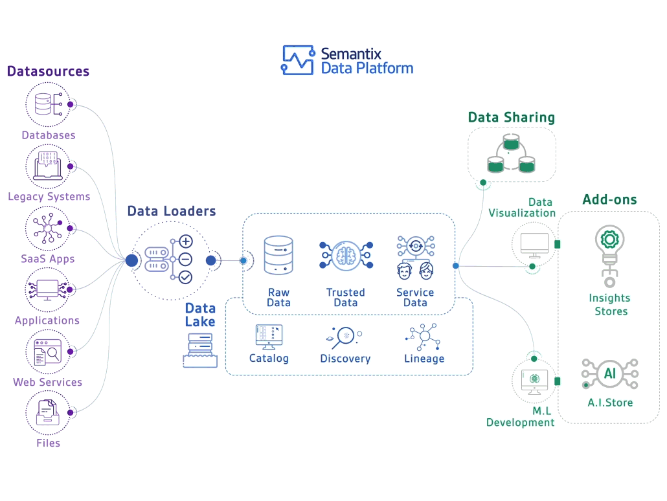

Slide 15


Slide 16

I tried to understand the modern data warehouse on my own…
And felt like I was body slammed by Randy Savage:
Let’s prevent that from happening…

Slide 17





LOB
CRM
BI + Reporting
INGEST
STORE
PREP
MODEL & SERVE
(& store)
Graph
Advanced Analytics
Image
Social
Data orchestration and monitoring
Big data store
Transform & Clean
Data warehouse
AI
IoT
Azure Data Factory
SSIS
Azure Data Lake Storage Gen2
Blob Storage
Azure Data Lake Storage Gen1
SQL Server 2019 Big Data Cluster
Azure Databricks
Azure HDInsight
PolyBase & Stored Procedures
Power BI Dataflow
Azure SQL Data Warehouse
Azure Analysis Services
SQL Database (Single, MI, HyperScale, Serverless)
SQL Server in a VM
^{Azure Data Lake Analytics} Cosmos DB
Power BI Aggregations

Slide 18
Questions to ask customer
Can you use the cloud?
Is this a new solution or a migration?
What is the skillset of the developers?
Will you use non-relational data (variety)?
How much data do you need to store (volume)?
Is this an OLTP or OLAP/DW solution?
Will you have streaming data (velocity)?
Will you use dashboards and/or ad-hoc queries?
Will you use batch and/or interactive queries?
How fast do the operational reports need to run?
Will you do predictive analytics?
Do you want to use Microsoft tools or open source?
What are your high availability and/or disaster recovery requirements?
Do you need to master the data (MDM)?
Are there any security limitations with storing data in the cloud?
Does this solution require 24/7 client access?
How many concurrent users will be accessing the solution at peak-time and on average?
What is the skill level of the end users?
What is your budget and timeline?
Is the source data cloud-born and/or on-prem born?
How much daily data needs to be imported into the solution?
What are your current pain points or obstacles (performance, scale, storage, concurrency, query times, etc)?
Are you ok with using products that are in preview?

Slide 19


Slide 20
LOB
CRM
BI + Reporting
INGEST
STORE
PREP
MODEL & SERVE
(& store)
Graph
Advanced Analytics
Image
Social
Data orchestration and monitoring
Big data store
Transform & Clean
Data warehouse
AI
IoT
Azure Data Factory
SSIS
Azure Data Lake Storage Gen2
Blob Storage
Azure Data Lake Storage Gen1
SQL Server 2019 Big Data Cluster
Azure Databricks
Azure HDInsight
PolyBase & Stored Procedures
Power BI Dataflow
Azure SQL Data Warehouse
Azure Analysis Services
SQL Database (Single, MI, HyperScale, Serverless)
SQL Server in a VM
^{Azure Data Lake Analytics} Cosmos DB
Power BI Aggregations

Slide 21
Data Ingestion
Product Name ​ | Overview​
Azure Data Factory(ADF)​ | With Mapping Data Flow, can now transform data, so ETL tool. Copy Data tool to easily copy from source to destination. Added templates.​
SSIS​ | Very popular product, used for on prem ETL for many years​

Slide 22
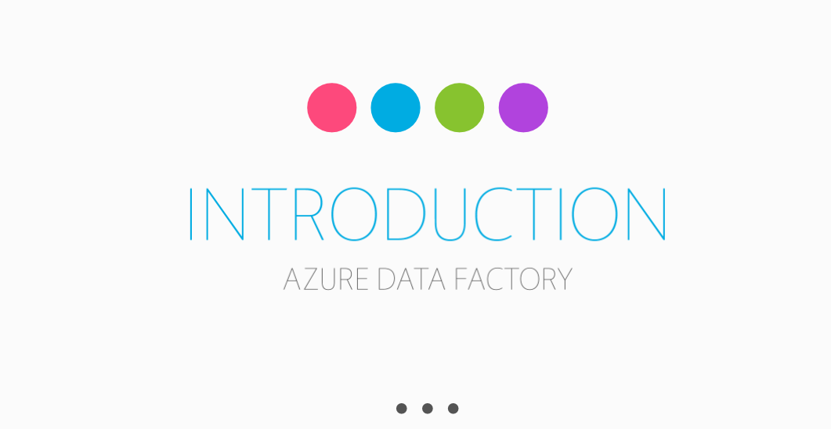

Slide 23
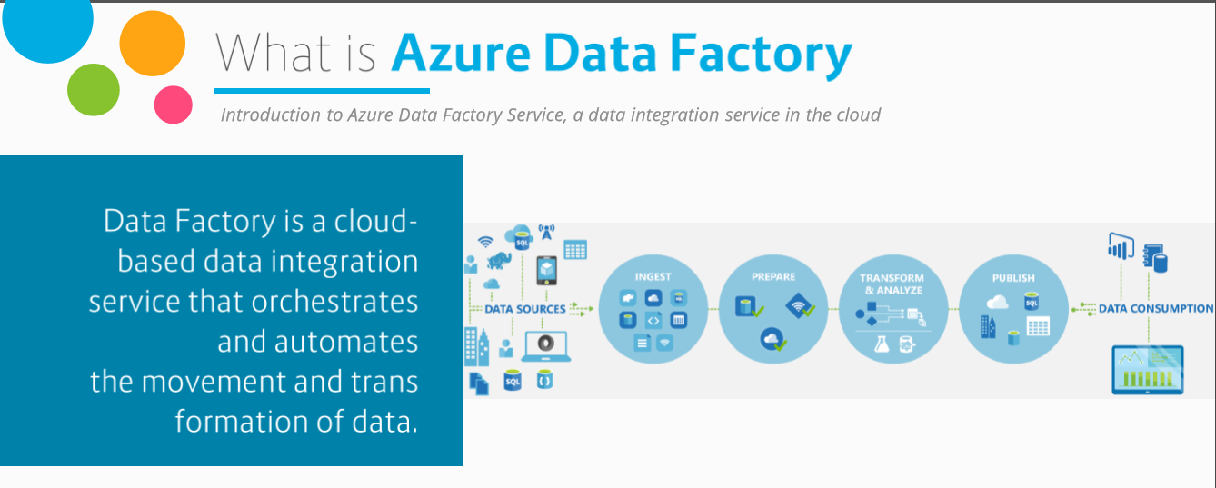
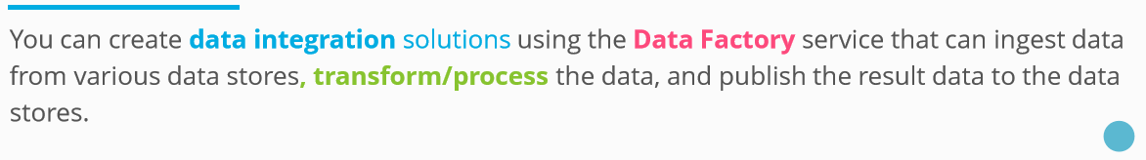

Slide 24
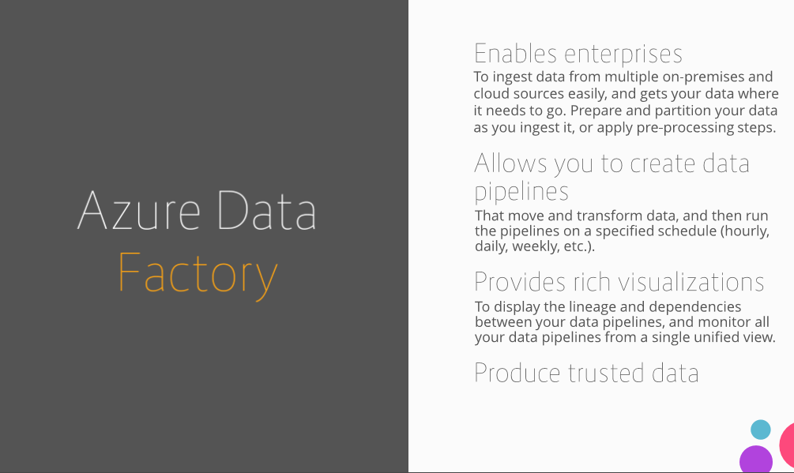

Slide 25
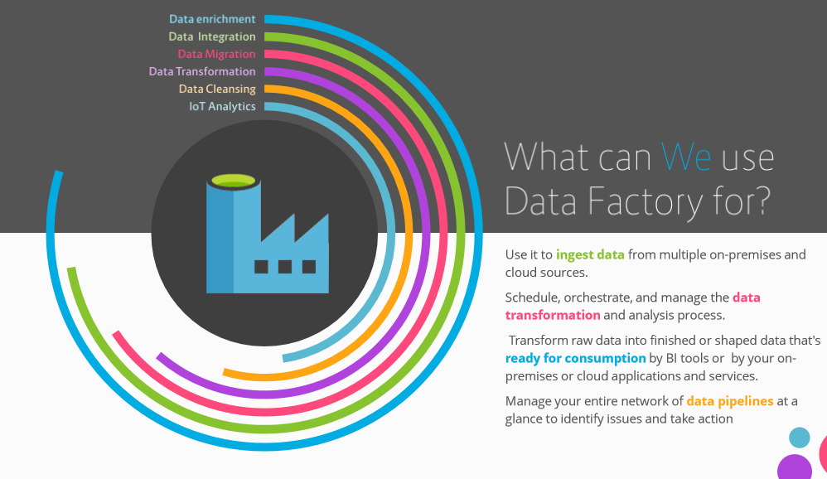

Slide 26
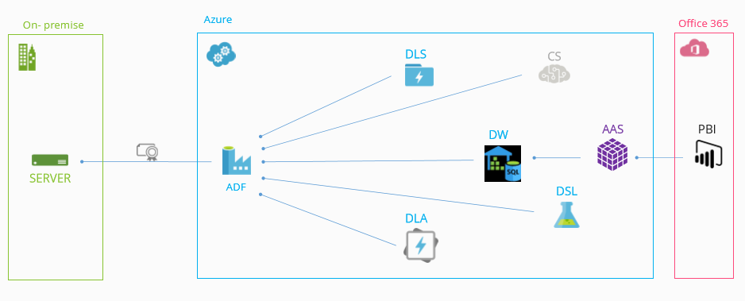
Data Sources Usage

Slide 27
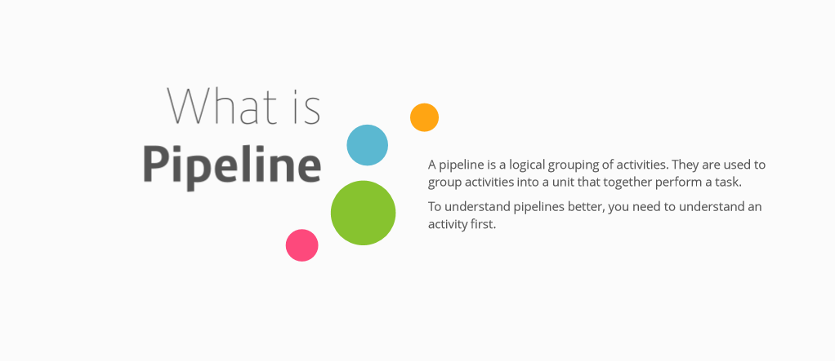

Slide 28
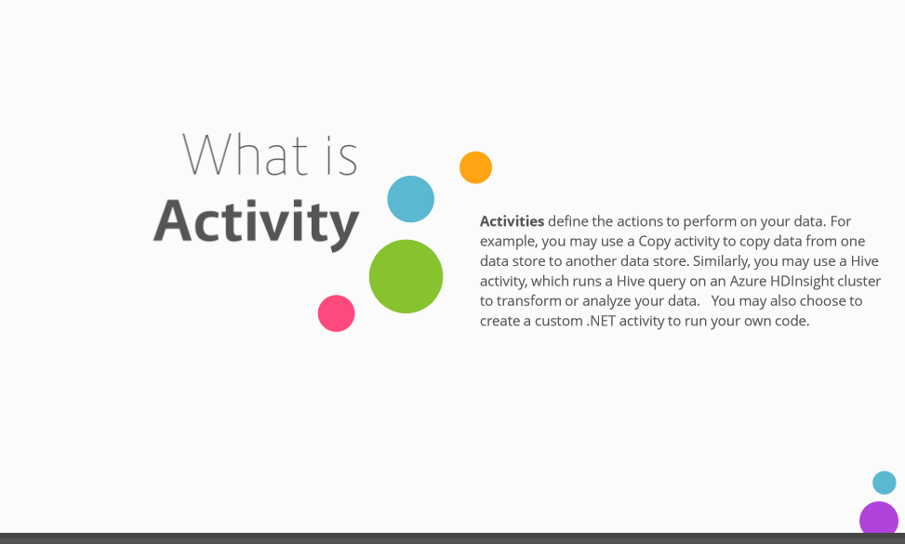

Slide 29
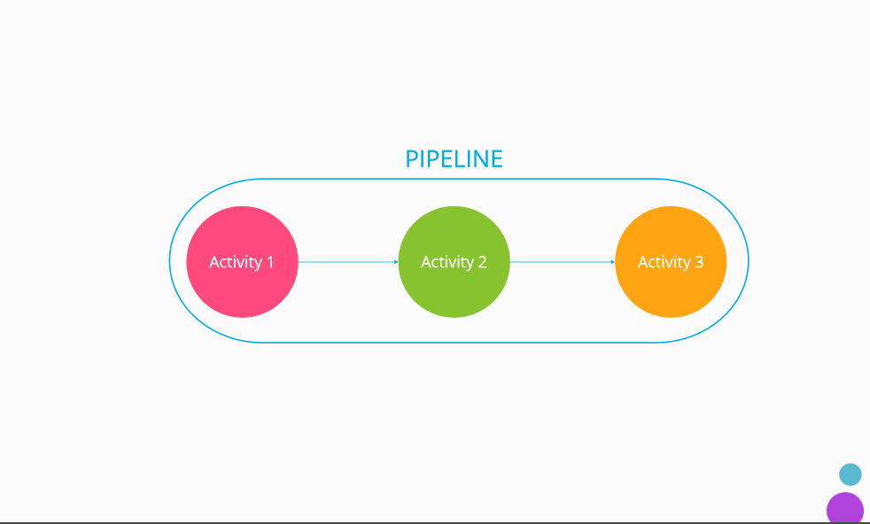

Slide 30
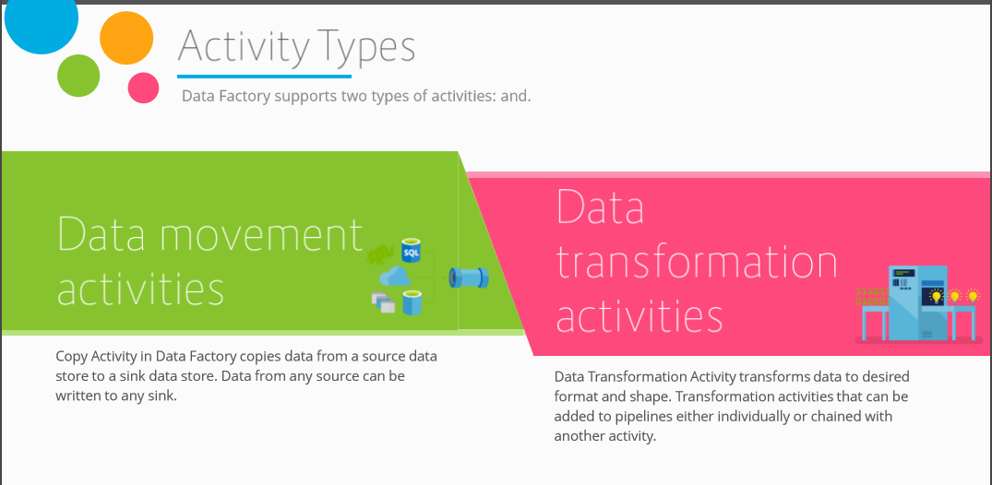

Slide 31
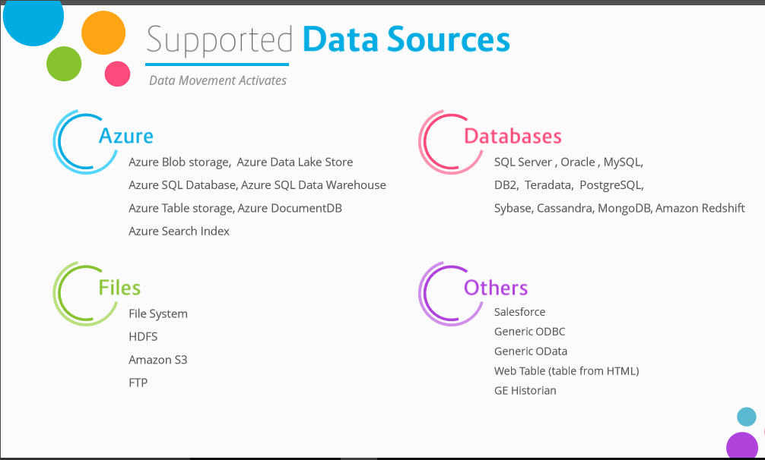

Slide 32
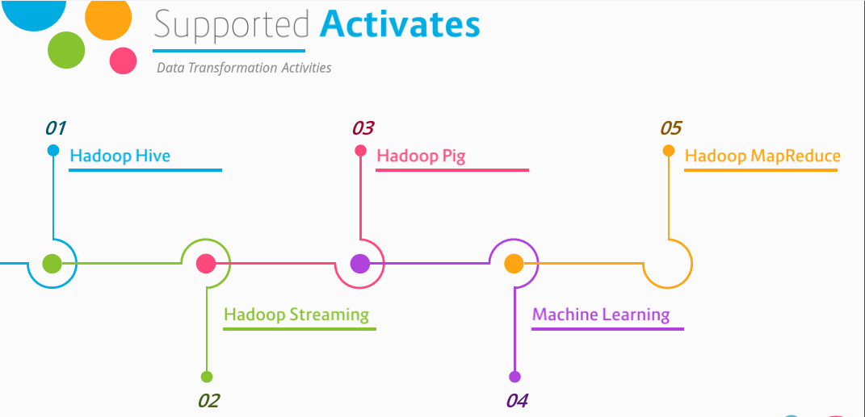

Slide 33
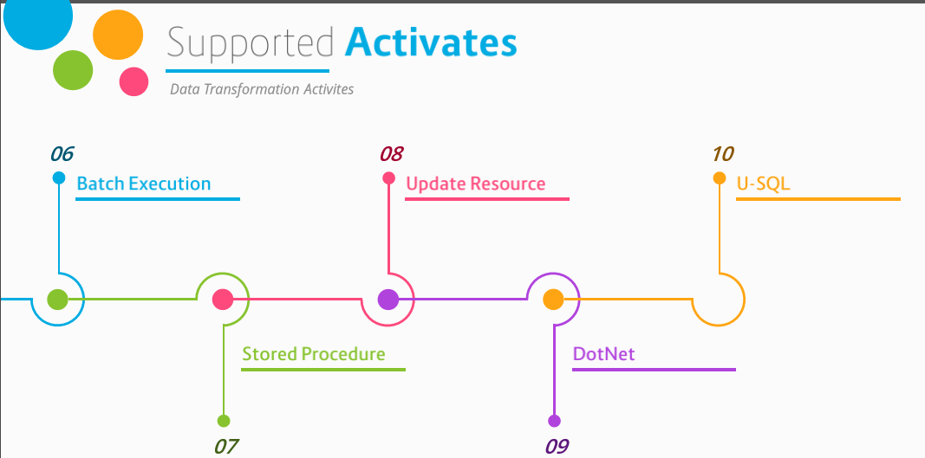

Slide 34
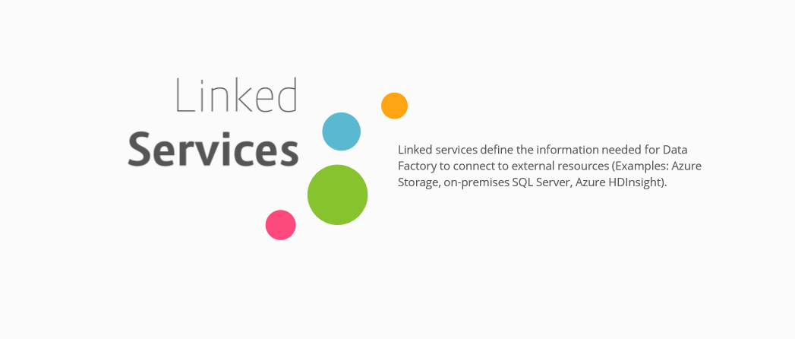

Slide 35
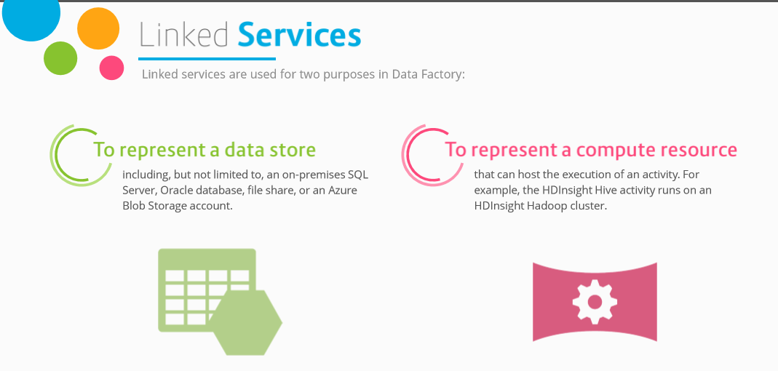

Slide 36
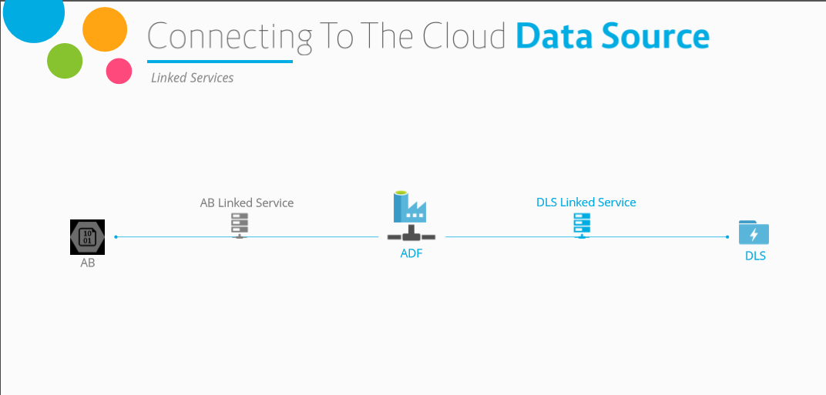

Slide 37
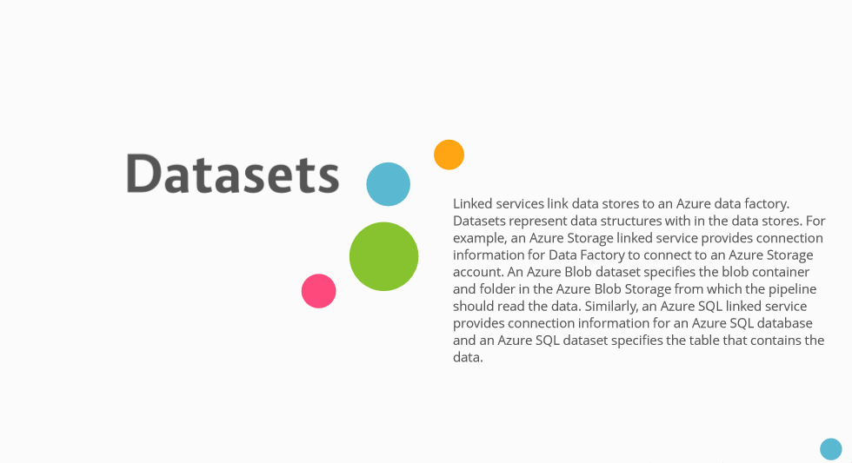

Slide 38
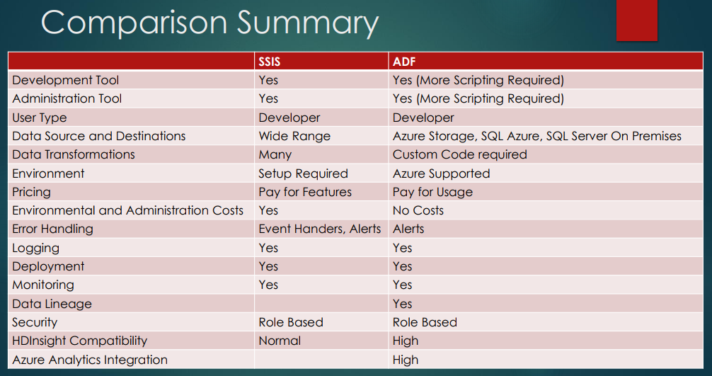

Slide 39
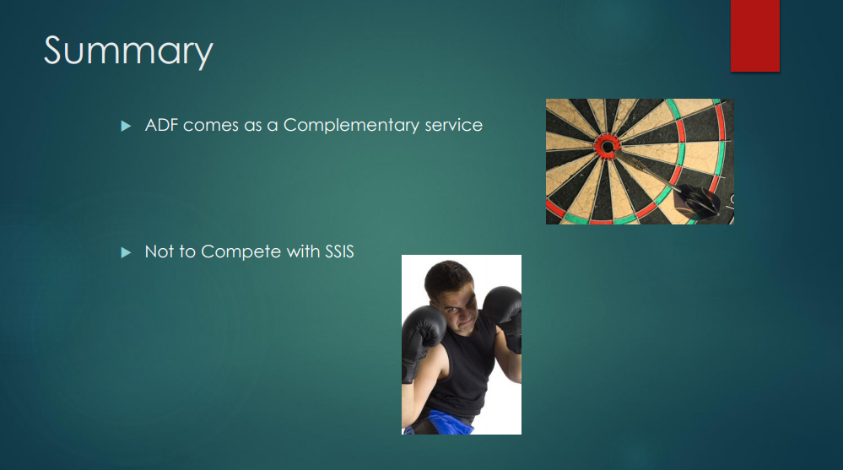

Slide 40



Slide 41
LOB
CRM
INGEST
Data orchestration and monitoring
STORE Big data store | PREP Transform & Clean | MODEL & SERVE (& store) Data warehouse
Azure Data Lake Storage Gen2 Blob Storage Azure Data Lake Storage Gen1 SQL Server 2019 Big Data Cluster
BI + Reporting
Graph
Advanced Analytics
Image
Social
AI
IoT
Azure Data Factory
SSIS
Azure Databricks
Azure HDInsight
PolyBase & Stored Procedures
Power BI Dataflow
Azure SQL Data Warehouse
Azure Analysis Services
SQL Database (Single, MI, HyperScale, Serverless)
SQL Server in a VM
^{Azure Data Lake Analytics} Cosmos DB
Power BI Aggregations

Slide 42
Store – Big Data
Product Name ​ | Overview​
Azure Data Lake Storage Gen2(ADLS Gen2)​ | GA Feb 7th! Combines best features of blob storage and ADLS Gen1​
Blob Storage​ | non-analytical use cases that only need object storage rather than hierarchical storage(i.e. video, images, backup files). Don’t migrate to Gen2 if current data does not need features of ADLS Gen2​
Azure Data Lake Storage Gen1(ADLS Gen1)​ | Originally for better performance over Blob storage​
SQL Server 2019 Big Data Cluster​ | Combines together the SQL Server database engine, Spark, and HDFS(including ADLS Gen2) into a unified data platform deployed as containers on Kubernetes. Also uses Polybase to access many types of data sources​

Slide 43
Zone 1
Zone 2
Zone 3
LRS
Multiple replicas across a datacenter
Protect against disk, node, rack failures
Write is ack’d when all replicas are committed
Superior to dual-parity RAID
11 9s of durability
SLA: 99.9%
ZRS
GRS
RA-GRS
Replicas across 3 Zones
Protect against disk, node, rack and zone failures
Synchronous writes to all 3 zones
12 9s of durability Available in 8 regions SLA: 99.9%
Multiple replicas across each of 2 regions
Protects against major regional disasters
Asynchronous to secondary 16 9s of durability
SLA: 99.9%
GRS + Read access to secondary Separate secondary endpoint
RPO delay to secondary can be queried
SLA: 99.99% (read), 99.9% (write)

Slide 44





Azure Data Lake Storage Gen 2
A “no-compromises” Data Lake: secure, performant, massively-scalable Data Lake storage that brings the cost and scale profile of object storage together with the performance and analytics feature set of data lake storage
S E C U R E
F A S T
S C A L A B L E
C O S T
E F F E C T I V E
I N T E G R A T I O N R E A D Y
M A N A G E A B L E
Support for fine- grained ACLs, protecting data at the file and folder level
Multi-layered protection via at-rest Storage Service encryption and Azure Active Directory integration
Automated Lifecycle Policy Management
Atomic file operations means jobs complete faster
No limits on data store size
Object store pricing levels
Optimized for Spark and Hadoop Analytic Engines
Global footprint (50 regions)
File system operations minimize transactions required for job completion
Object Level
tiering
Tightly integrated with Azure end to end analytics solutions

Slide 45


Slide 46
LOB
CRM
BI + Reporting
INGEST
STORE
PREP
MODEL & SERVE
(& store)
Graph
Advanced Analytics
Image
Social
Data orchestration and monitoring
Big data store
Transform & Clean
Data warehouse
AI
IoT
Azure Data Factory
SSIS
Azure Data Lake Storage Gen2
Blob Storage
Azure Data Lake Storage Gen1
SQL Server 2019 Big Data Cluster
Azure Databricks
Azure HDInsight
PolyBase & Stored Procedures
Power BI Dataflow
Azure Data Lake Analytics
Azure SQL Data Warehouse
Azure Analysis Services
SQL Database (Single, MI, HyperScale, Serverless)
SQL Server in a VM Cosmos DB
Power BI Aggregations

Slide 47
Prep – Transform & Clean
Product Name | Overview
Azure HDInsight(HDI) | Deploys and provisions Apache Hadoop clusters in the Azure cloud. Hortonworks under the covers
PolyBase & Stored Procedures (within SQL DW) | Process T SQL queries that copy raw data from data lake (ADLS or Blob storage) via an external table into SQL DW, then clean via stored procedures
PowerBI Dataflow | Integrates data lake and data prep technology(Power Query) directly into Power BI Service, independent of PBI reports. Self-service data prep
Azure Data Lake Analytics(ADLA) | Dynamically provisions resources so you can run queries on petabytes of data. Query as a service using U SQL
Azure Databricks | Tool for curating and processing massive amounts of data and developing, training and deploying models on that data,and managing the whole workflow process throughout the project

Slide 48



Slide 49
LOB
CRM
BI + Reporting
INGEST
STORE
PREP
MODEL & SERVE
(& store)
Graph
Advanced Analytics
Image
Social
Data orchestration and monitoring
Big data store
Transform & Clean
Data warehouse
AI
IoT
Azure Data Factory
SSIS
Azure Data Lake Storage Gen2
Blob Storage
Azure Data Lake Storage Gen1
SQL Server 2019 Big Data Cluster
Azure Databricks
Azure HDInsight
PolyBase & Stored Procedures
Power BI Dataflow
Azure Data Lake Analytics
Azure SQL Data Warehouse
Azure Analysis Services
SQL Database (Single, MI, HyperScale, Serverless)
SQL Server in a VM Cosmos DB
Power BI Aggregations

Slide 50
Model & Serve
Product Name | Overview
Azure SQL Data Warehouse(SQL DW) | SQL-based, fully-managed, petabyte-scale cloud data warehouse. Can scale compute and storage independently allowing you to burst compute, and can be paused
Azure Analysis Services (AAS) | Tabular models of aggregated data(OLAP)
SQL Database. Programming model: Instance(MI), Database(Single); Service tiers: General Purpose, Business Critical, Hyperscale; Resource grouping concept: Elastic pools | Database as a service in different flavors: MI(near 100% compatibility, great for on perm migrations), Single(additional DTU model,less compatibility, lower price of entry), Hyperscale (up to100TB database size, higher performance)
SQL Server in a VM | SQL Server in a VM
Cosmos DB | A globally distributed, multi-model (Key-value, graph, and document) database service. It fits into the NoSQL camp by having a non-relational model(supporting schema-on-read and JSON documents)
Power BI with Aggregations | Tabular models of aggregated data

Slide 51






Slide 52

BI & Analytics Decision Tree
When to use what !!!

Slide 53
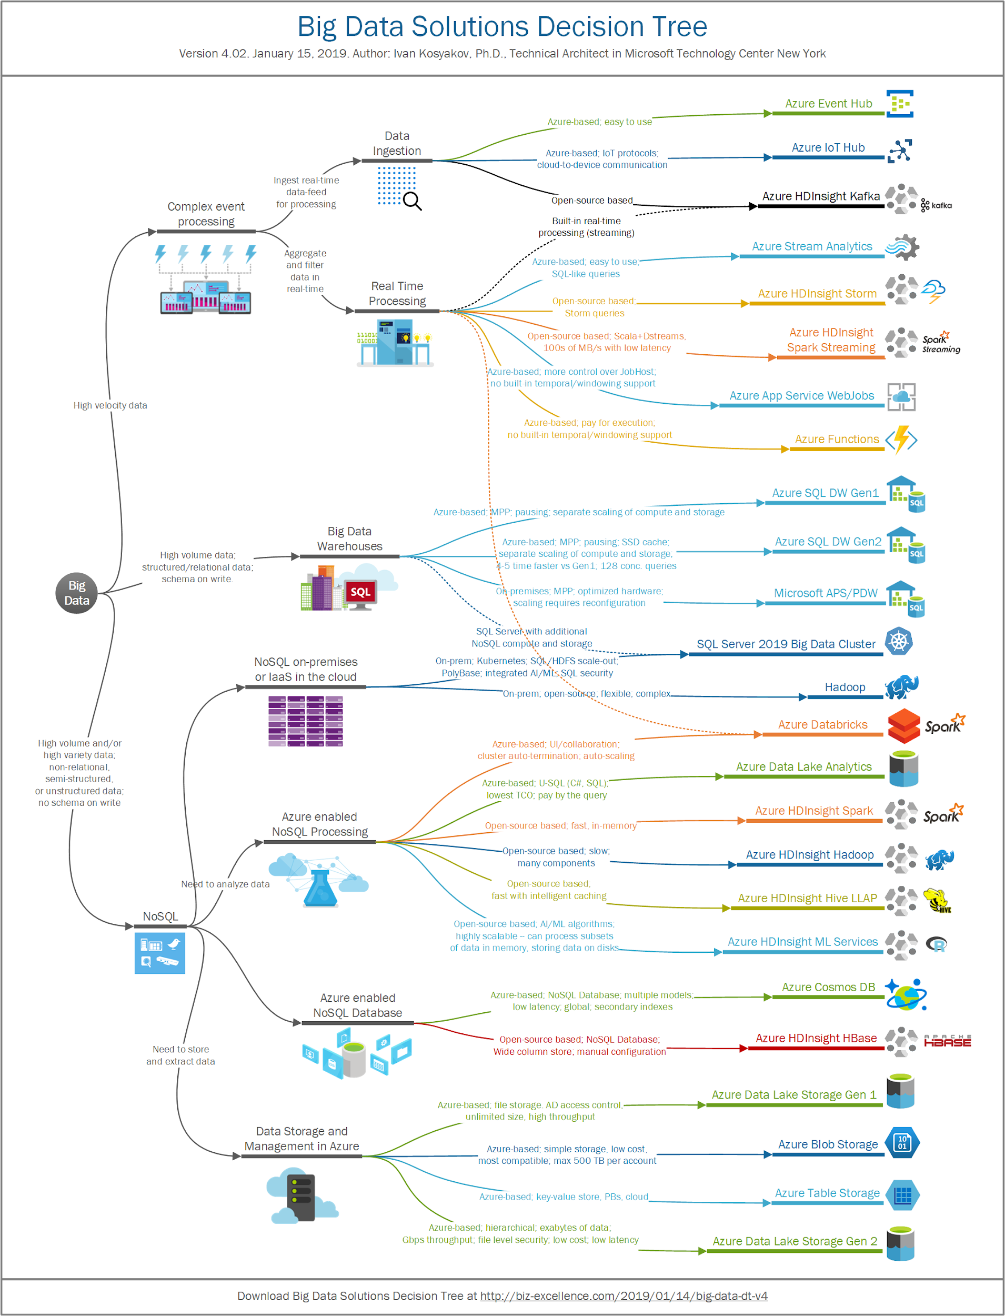

Slide 54
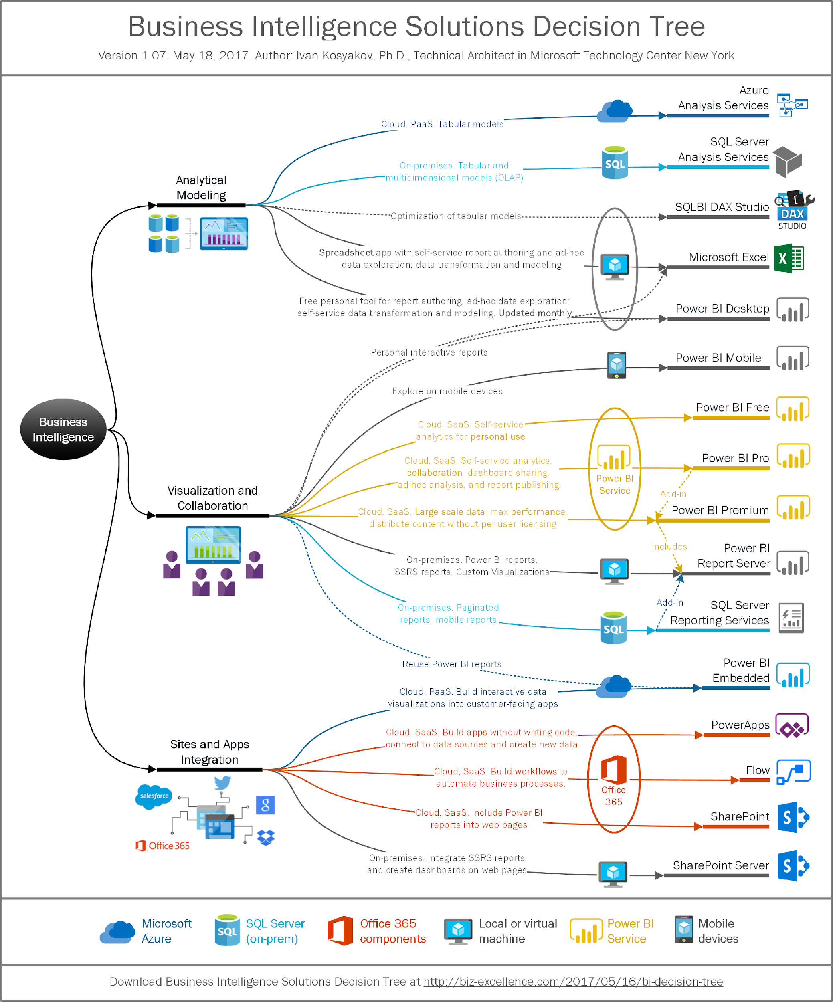

Slide 55
Microsoft data platform solutions
Product | Category | Description | More Info
SQL Server 2017 | RDBMS | Earned top spot in Gartner’s Operational Database magic quadrant. JSON support. Linux support | https://www.microsoft.com/en-us/server- cloud/products/sql-server-2017/
SQL Database | RDBMS/DBaaS | Cloud-based service that is provisioned and scaled quickly. Has built-in high availability and disaster recovery. JSON support. Managed Instance option | https://azure.microsoft.com/en- us/services/sql-database/
SQL Data Warehouse | MPP RDBMS/DBaaS | Cloud-based service that handles relational big data. Provision and scale quickly. Can pause service to reduce cost | https://azure.microsoft.com/en- us/services/sql-data-warehouse/
Azure Data Lake Store | Hadoop storage | Removes the complexities of ingesting and storing all of your data while making it faster to get up and running with batch, streaming, and interactive analytics | https://azure.microsoft.com/en- us/services/data-lake-store/
HDInsight | PaaS Hadoop compute/Hadoop clusters-as-a-service | A managed Apache Hadoop, Spark, R Server, HBase, Kafka, Interactive Query (Hive LLAP) and Storm cloud service made easy | https://azure.microsoft.com/en- us/services/hdinsight/
Azure Databricks | PaaS Spark clusters | A fast, easy, and collaborative Apache Spark based analytics platform optimized for Azure | https://databricks.com/azure
Azure Data Lake Analytics | On-demand analytics job service/Big Data-as-a- service | Cloud-based service that dynamically provisions resources so you can run queries on exabytes of data. Includes U- SQL, a new big data query language | https://azure.microsoft.com/en- us/services/data-lake-analytics/
Azure Cosmos DB | PaaS NoSQL: Key-value, Column-family, Document, Graph | Globally distributed, massively scalable, multi-model, multi- API, low latency data service – which can be used as an operational database or a hot data lake | https://azure.microsoft.com/en- us/services/cosmos-db/
Azure Database for PostgreSQL, MySQL, and MariaDB | RDBMS/DBaaS | A fully managed database service for app developers | https://azure.microsoft.com/en- us/services/postgresql

Slide 56
Lab Setup overview.
Approaches for utilizing Azure Synapse.

Slide 57
Architecture Patterns
Best practices and methodologies

Slide 58
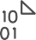


C L O U D
D A T A
W A R E H O U S E
INGEST
STORE
PREP & TRAIN
MODEL & SERVE
Logs (unstructured)
Media (unstructured)
PolyBase
Files (unstructured)
Azure Data Factory
Azure Data Lake Store Gen2
Azure SQL Data Warehouse
Azure Analysis Services
Power BI
Business/custom apps
(structured)
Microsoft Azure also supports other Big Data services like Azure HDInsight to allow customers to tailor the above architecture to meet their unique needs.

Slide 59
M O D E R N
D A T A
W A R E H O U S E
INGEST
STORE
PREP & TRAIN
MODEL & SERVE
Logs (unstructured)
Azure Databricks
Media (unstructured)
PolyBase
Files (unstructured)
Azure Data Factory
Azure Data Lake Store Gen2
Azure SQL Data Warehouse
Azure Analysis Services
Power BI
Business/custom apps
(structured)
Microsoft Azure also supports other Big Data services like Azure HDInsight to allow customers to tailor the above architecture to meet their unique needs.

Slide 60



A D V A N C E D A N A L Y T I C S O N B I G D A T A
INGEST
STORE
PREP & TRAIN
MODEL & SERVE
Logs (unstructured)
Azure Databricks
SparkR
Cosmos DB
Real-time apps
Media (unstructured)
PolyBase
Files (unstructured)
Azure Data Factory
Azure Data Lake Store Gen2
Azure SQL Data Warehouse
Azure Analysis Services
Power BI
Business/custom apps
(structured)
Microsoft Azure also supports other Big Data services like Azure HDInsight, Azure Machine Learning to allow customers to tailor the above architecture to meet their unique needs.

Slide 61




R E A L
T I M E
A N A L Y T I C S
INGEST
STORE
PREP & TRAIN
MODEL & SERVE
Sensors and IoT (unstructured)
Azure Databricks
Logs (unstructured)
Apache Kafka for HDInsight
Cosmos DB
Real-time apps
Media (unstructured)
Files (unstructured)
PolyBase
Business/custom apps (structured)
Azure Data Factory
Azure Data Lake Store Gen2
Azure SQL Data Warehouse
Azure Analysis Services
Power BI
Microsoft Azure also supports other Big Data services like Azure IoT Hub, Azure Event Hubs, Azure Machine Learning to allow customers to
tailor the above architecture to meet their unique needs.

Slide 62





D A T A
M A R T
C O N S O L I D A T I O N
INGEST
STORE
MODEL & SERVE
PolyBase
RDBMS data marts
Azure Data Factory
Azure Data Lake Store Gen2
Azure SQL Data Warehouse
Azure Analysis Services
Power BI
Hadoop
Microsoft Azure also supports other Big Data services like Azure HDInsight to allow customers to tailor the architecture to meet their unique needs.

Slide 63



H U B & S P O K E A R C H I T E C T U R E F O R B I
INGEST
STORE
PREP & TRAIN
MODEL & SERVE
Data Marts
SQL
Multiple Azure SQL Database instances
Business/custom apps (structured)
Azure Databricks
Logs (unstructured)
PolyBase
Azure Data Factory
Azure Data Lake Store Gen2
Azure SQL Data Warehouse
Power BI
Media (unstructured)
Data Cubes
Multiple Azure Analysis Services instances
Files (unstructured)
Microsoft Azure supports other services like Azure HDInsight to allow customers a truly customized solution.

Slide 64
A U T O
S C A L I N G
D A T A
W A R E H O U S E
INGEST
STORE
PREP & TRAIN
MODEL & SERVE
Business/custom apps (structured)
Azure Databricks
Logs (unstructured)
PolyBase
Azure Data Factory
Azure Data Lake Store Gen2
Azure SQL Data Warehouse
Azure Analysis Services
Power BI
Media (unstructured)
Azure Functions (Auto-scaling)
Files (unstructured)
Microsoft Azure supports other services like Azure HDInsight to allow customers a truly customized solution.

Slide 65



D A T A
W A R E H O U S E
M I G R A T I O N
INGEST
STORE
PREP & TRAIN
MODEL & SERVE
Business/custom apps (structured)
PolyBase
Azure SQL Data Warehouse
Business/custom apps
Logs (unstructured)
Azure Analysis Services
Media (unstructured)
Azure Data Factory
Azure Data Lake Store Gen2
Azure Databricks
Power BI
Files (unstructured)
Azure also supports other Big Data services like Azure HDInsight to allow customers to tailor the architecture to meet their unique needs.

Slide 66

Azure Synapse Analytics
Limitless analytics service with unmatched time to insight
Artificial Intelligence / Machine Learning / Internet of Things
Intelligent Apps / Business Intelligence
Designed for analytics workloads at any scale
Synapse Analytics
SaaS developer experiences for code free and code first
Experience
Synapse Analytics Studio
Platform
Multiple languages suited to different analytics workloads
MANAGEMENT
Languages
MANAGEMENT
SQL
Python
.NET
Java
Scala
Integrated analytics runtimes available dedicated and serverless
Synapse SQL offering T-SQL for batch, streaming and interactive processing
Apache Spark for big data processing with Python, Scala and .NET
SECURITY
Form Factors
SECURITY
DEDICATED
SERVERLESS
MONITORING
Analytics Runtimes
MONITORING
SQL
METASTORE
METASTORE
DATA INTEGRATION
Integrated platform services for, management, security, monitoring, and meta-store
Azure
Data Lake Storage
Common Data Model
Enterprise Security
Optimized for Analytics
Data lake integrated and Common Data Model aware
Notes:
Hand it over to Lino

Slide 67
Modern Data Warehouse
INGEST
PREPARE
TRANSFORM & ENRICH
SERVE
VISUALIZE
STORE

Slide 68

5 minutes break !!

Slide 69
Ingest - Orchestration with Pipelines

Slide 70


Components of Orchestration
Trigger
Pipeline
foreach (…)
On demand
Schedule
Data Window
Event
Activity
Activity
Activity
Activity
Activity
Self-hosted
Integration Runtime
Azure
Integration Runtime
Linked
Service
LEGEND
On-prem
Apps & Data
Azure Services
Command and Control
Data
Synapse Pipelines shares codebase with Azure Data Factory

Slide 71
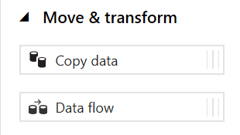
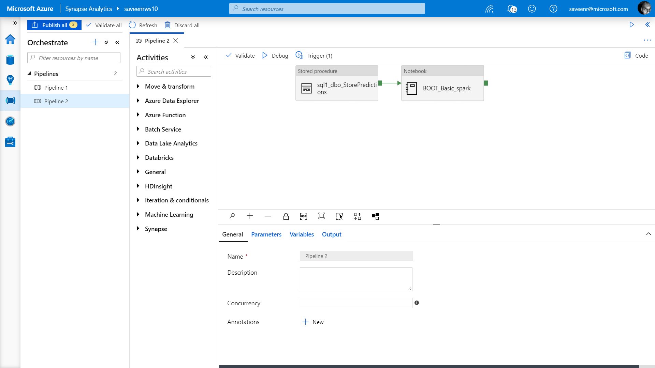
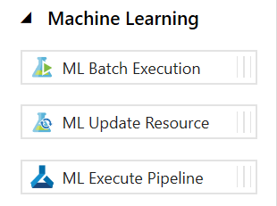
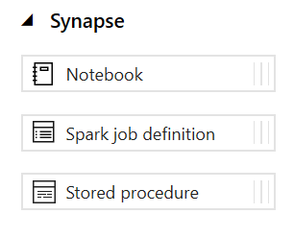
Pipelines
Create pipelines to ingest, transform and load data with 90+ inbuilt connectors.
Offers a wide range of activities that a pipeline can perform.

Slide 72
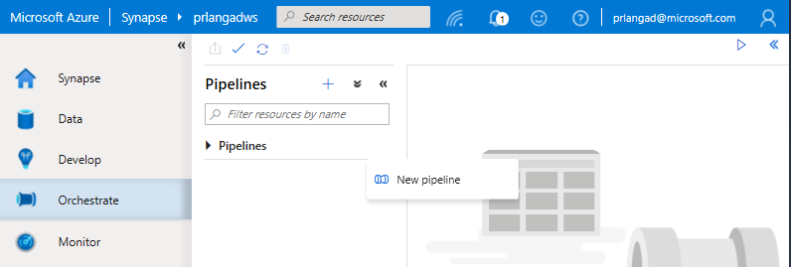
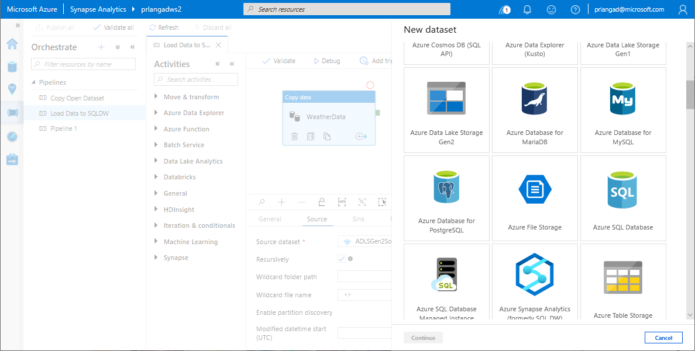
Pipelines
Overview
Provide ability to load data from storage account to desired linked service.
Load data by manual execution of pipeline or by orchestration.
Benefits
Supports common loading patterns.
Fully parallel loading into data lake or SQL tables.
Graphical development experience.

Slide 73
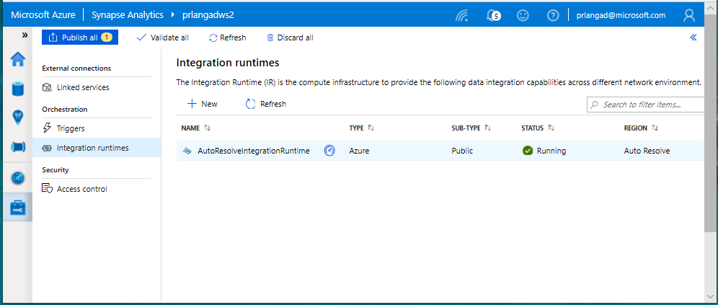
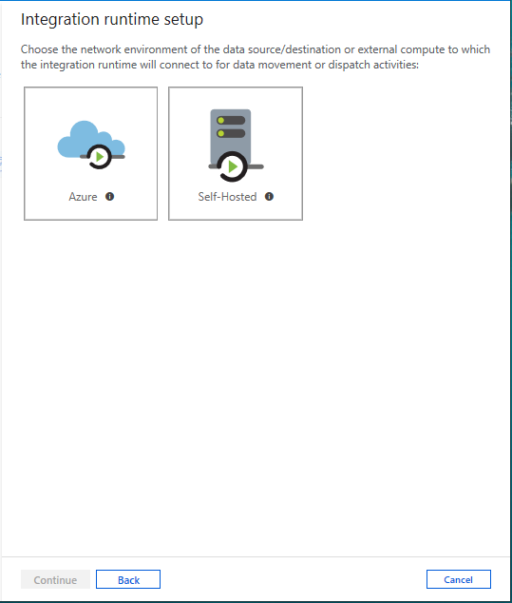
Integration runtimes
Overview
Integration runtimes are the compute infrastructure used by Pipelines to provide the data integration capabilities across different network environments. An integration runtime provides the bridge between the activity and linked services.
Benefits
Offers Azure Integration Runtime or Self-Hosted Integration Runtime
Azure Integration Runtime – provides fully managed, serverless compute in Azure
Self-Hosted Integration Runtime – use compute resources in on-premises machine or a VM inside private network
Notes:
Need to explain and why needed
Check with Gaurav

Slide 74
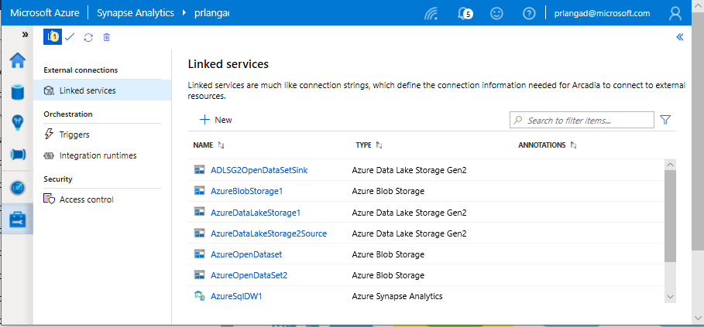
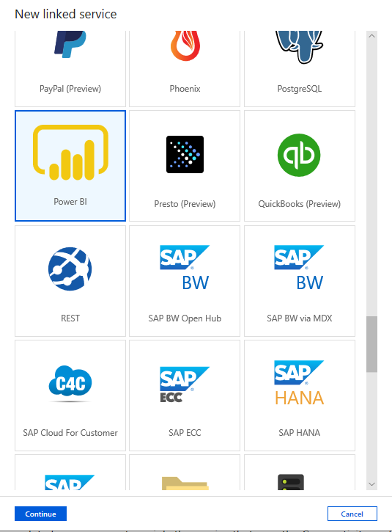
Linked services
Overview
Linked services define the connection information needed to connect to external resources.
Benefits
Offers pre-build 90+ connectors
Easy cross platform data migration
Represents data store or compute resources

Slide 75
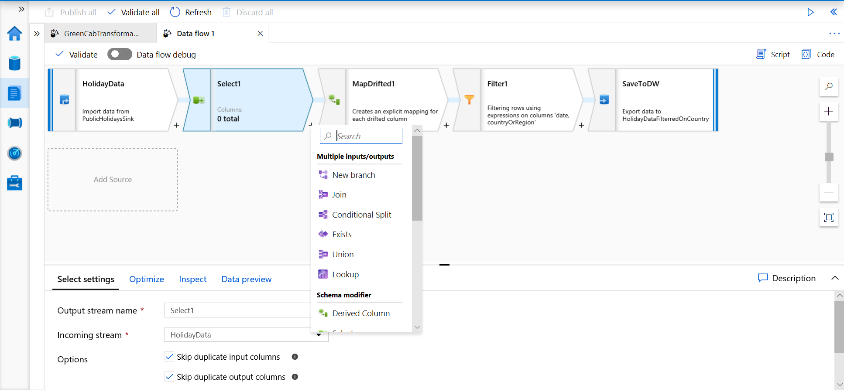
Develop Hub - Data Flows
Data flows are a visual way of specifying how to transform data.
Provides a code-free experience.

Slide 76
Data Flow Capabilities
Handle upserts, updates, deletes on sql sinks
Add new partition methods
Add schema drift support
Add file handling (move files after read, write files to file names described in rows etc)
New inventory of functions (for e.g Hash functions for row comparison)
Commonly used ETL patterns(Sequence generator/Lookup transformation/SCD…)
Data lineage – Capturing sink column lineage & impact analysis(invaluable if this is for enterprise deployment)
Implement commonly used ETL patterns as templates(SCD Type1, Type2, Data Vault)

Slide 77
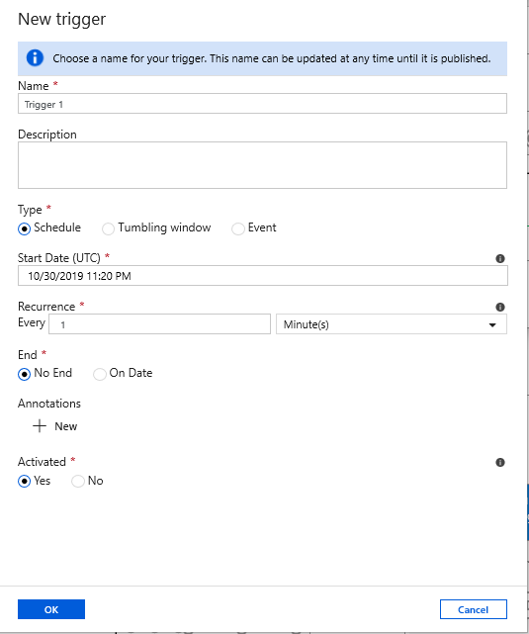
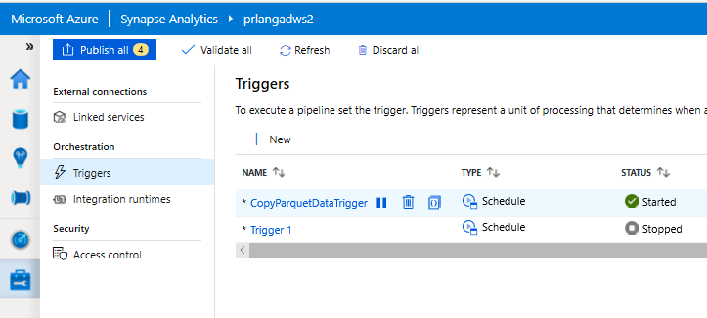
Triggers
Overview
Triggers represent a unit of processing that determines when a pipeline execution needs to be kicked off.
Data Integration offers 3 trigger types as –
Schedule – gets fired at a schedule with information of start date, recurrence, end date
Event – gets fired on specified Storage event
Tumbling window – gets fired at a periodic time interval from a specified start date, while retaining state
It also provides ability to monitor pipeline runs and control trigger execution.

Slide 78
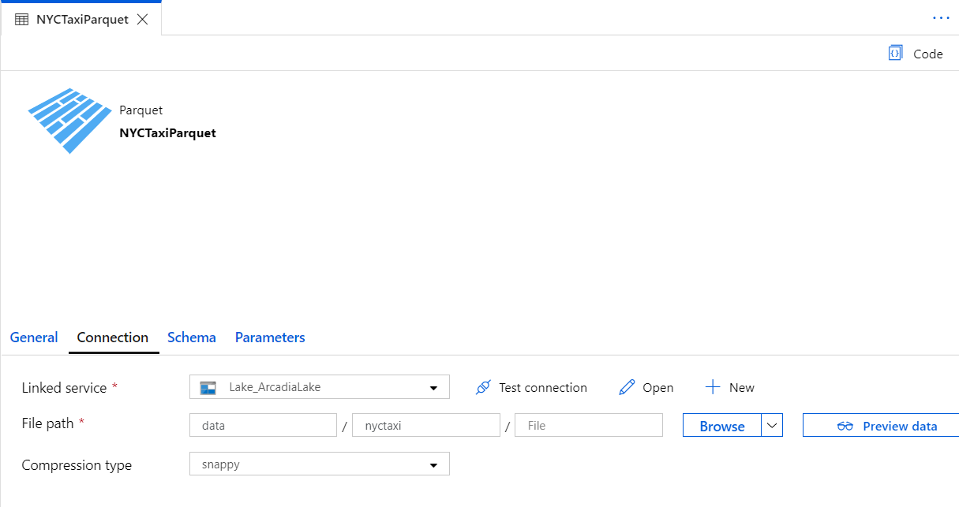
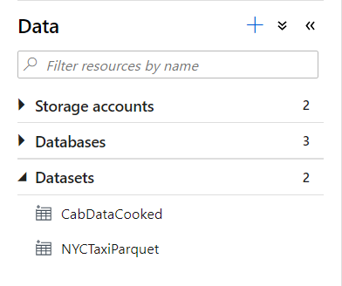
Datasets
Orchestration datasets describe data that is persisted.
Once a dataset is defined, it can be used in pipelines and sources of data or as sinks of data.

Slide 79
90+ Connectors out of the box
Azure (15) | Database & DW (26) |  | File Storage (6) | File Formats(6) | NoSQL (3) | Services and App (28) |  | Generic (4)
Blob storage | Amazon Redshift | Oracle | Amazon S3 | AVRO | Cassandra | Amazon MWS | Oracle Service Cloud | Generic HTTP
Cosmos DB - SQL API | DB2 | Phoenix | File system | Binary | Couchbase | CDS for Apps | PayPal | Generic OData
Cosmos DB - MongoDB API | Drill | PostgreSQL | FTP | Delimited Text | MongoDB | Concur | QuickBooks | Generic ODBC
Data Explorer | Google BigQuery | Presto | Google Cloud Storage | JSON |  | Dynamics 365 | Salesforce | Generic REST
Data Lake Storage Gen1 | Greenplum | SAP BW Open Hub | HDFS | ORC |  | Dynamics AX | SF Service Cloud
Data Lake Storage Gen2 | HBase | SAP BW via MDX | SFTP | Parquet |  | Dynamics CRM | SF Marketing Cloud
Database for MariaDB | Hive | SAP HANA |  |  |  | Google AdWords | SAP C4C
Database for MySQL | Apache Impala | SAP table |  |  |  | HubSpot | SAP ECC
Database for PostgreSQL | Informix | Spark |  |  |  | Jira | ServiceNow
File Storage | MariaDB | SQL Server |  |  |  | Magento | Shopify
SQL Database | Microsoft Access | Sybase |  |  |  | Marketo | Square
SQL Database MI | MySQL | Teradata |  |  |  | Office 365 | Web table
SQL Data Warehouse | Netezza | Vertica |  |  |  | Oracle Eloqua | Xero
Search index |  |  |  |  |  | Oracle Responsys | Zoho
Table storage
Notes:
formatting

Slide 80
Pop Quiz
Which one of these is NOT a component of a Synapse pipeline?
A) I.R.
B)
Linked Service
C)
Table
D) Activity

Slide 81
Pop Quiz
Which one of these is NOT a component of a Synapse pipeline?
A) I.R.
B)
Linked Service
C)
Table
D) Activity

Slide 82
Ingesting files into tables

Slide 83
COPY command
Overview
Copies data from source to destination
Benefits
Retrieves data from all files from the folder and all its subfolders.
Supports multiple locations from the same storage account, separated by comma
Supports Azure Data Lake Storage (ADLS) Gen 2 and Azure Blob Storage.
Supports CSV, PARQUET, ORC file formats
COPY INTO test_1
FROM 'https://XYZ.blob.core.windows.net/customerdatasets/test_1.txt'
WITH (
FILE_TYPE = 'CSV',
CREDENTIAL=(IDENTITY= 'Shared Access Signature', SECRET='<Your_SAS_Token>'),
FIELDQUOTE = '"',
FIELDTERMINATOR=';',
ROWTERMINATOR='0X0A',
ENCODING = 'UTF8',
DATEFORMAT = 'ymd',
MAXERRORS = 10,
ERRORFILE = '/errorsfolder/'--path starting from the storage container,
IDENTITY_INSERT
)
COPY INTO test_parquet
FROM 'https://XYZ.blob.core.windows.net/customerdatasets/test.parquet'
WITH (
FILE_FORMAT = myFileFormat
CREDENTIAL=(IDENTITY= 'Shared Access Signature', SECRET='<Your_SAS_Token>')
)

Slide 84
Create External Table As Select (Polybase)
-- Create a database master key if one does not already exist
CREATE MASTER KEY ENCRYPTION BY PASSWORD = 'S0me!nfo'
;
-- Create a database scoped credential with Azure storage account key as the secret.
CREATE DATABASE SCOPED CREDENTIAL AzureStorageCredential
WITH
IDENTITY = '<my_account>'
, SECRET = '<azure_storage_account_key>'
;
-- Create an external data source with CREDENTIAL option.
CREATE EXTERNAL DATA SOURCE MyAzureStorage
WITH
( LOCATION = 'wasbs://daily@logs.blob.core.windows.net/'
, CREDENTIAL = AzureStorageCredential
, TYPE = HADOOP
)
-- Create an external file format
CREATE EXTERNAL FILE FORMAT MyAzureCSVFormat
WITH (FORMAT_TYPE = DELIMITEDTEXT,
FORMAT_OPTIONS(
FIELD_TERMINATOR = ',',
FIRST_ROW = 2)
--Create an external table
CREATE EXTERNAL TABLE dbo.FactInternetSalesNew
WITH(
LOCATION = '/files/Customer',
DATA_SOURCE = MyAzureStorage,
FILE_FORMAT = MyAzureCSVFormat
)
AS SELECT T1.* FROM dbo.FactInternetSales T1 JOIN dbo.DimCustomer T2
ON ( T1.CustomerKey = T2.CustomerKey )
OPTION ( HASH JOIN );
Overview
Creates an external table and then exports results of the Select statement. These operations will import data into the database for the duration of the query
Steps:
Create Master Key
Create Credentials
Create External Data Source
Create External Data Format
Create External Table

Slide 85
Polybase vs Copy
Polybase
Copy
Currently in Preview
Relaxed permission
Slightly slower, but improving
No row width limit
Supports delimiters in text
Supports custom column and row delimiters
GA, stable
Needs CONTROL permission
Fastest (at present)
Enables querying via external tables
Challenges:
Row width
Delimiters in text
Fixed line delimiter
Code complexity

Slide 86
Best Practices for Ingest

Slide 87
Ingest Flat files to tables
Ingest flat file data into Azure Storage (Azure Data Lake Store Gen2)
When your data sources are on-premises, you need to move the data to Azure Storage before ingestion.
Data in other cloud platforms needs to be moved to Azure Storage before ingestion.
Load from flat files as relational tables within the data warehouse
Notes:
What specific approach would you say is the most efficient way for moving flat file data from the ingest storage locations to the data lake?
Follow the pattern of landing data in the data lake first, then ingest from the flat files into relational tables within the data warehouse. Then create pipelines that extract the source data and store in Azure Data Lake Store Gen2 as Parquet files.
What storage service would you recommend to use?
They should use Azure Data Lake Store (ADLS) Gen2 (Azure Storage with hierarchical file systems).

Slide 88
Ingest - Structuring ADLS Gen2
Separate storage accounts for each environment: dev, test, & production.
Use a common folder structure to organize data by degree of refinement.
ADLS Gen 2 Filesystem
Raw Data
/bronze
Query Ready
/silver
Report Ready
/gold
Notes:
How would you recommend to structure the folder to manage the data at the various levels of refinement?
They should use Azure Data Lake Store (ADLS) Gen2 (Azure Storage with hierarchical file systems).
In ADLS, it is a best practice to have a dedicated Storage Account for production, and a separate Storage Account for dev and test workloads. This will ensure that dev or test workloads never interfere with production.
One common folder structure is to organize the data in separate folders by degree of refinement. For example a bronze folder contains the raw data, silver contains the cleaned, prepared and integrated data and gold contains data ready to support analytics, which might include final refinements such as pre-computed aggregates.

Slide 89
Ingest from on-premises data sources
Fastest is done by batch:
Extract from data source to multiple CSV/Parquet files
Use AzCopy to upload to ADLS
Alternative is query-insert:
Set up SSIS self-hosted integration runtime on-premises
Use Synapse Pipeline to extract/copy
Use Synapse Pipeline to execute load procedure
Large Migrations:
Use Azure Data Box where available

Slide 90
Ingest from Cloud Data Sources
Options:
Extract using Synapse Pipelines
Write to ADLS as Parquet files
AzCopy is a fast move for files from S3 to ADLS

Slide 91
Ingest File Data Sources
Look out for these file format challenges…
Invalid file format
Multiple row types
Ragged columns
Row size > 1Mb
Datetime format/s (e.g., use of nanosecond date time)
NULL value literal/s
Free form text
Parquet partitions
XML data
Use of non-standard line delimiters (e.g., CR)
…and try these Solutions
Use Spark to pre-process and fix data errors
Flatten and parse XML in Spark
Use COPY to ingest complex CSV instead of Polybase

Slide 92
Ingest and Store – Formats
For batch flat files, Azure Synapse Analytics supports CSV, Parquet, ORC, and JSON formats.
Ingest streaming data messages/events via Event Hub or IoT Hub.
Parquet format recommended for storing ingested data at various levels of refinement.
Notes:
When it comes to ingesting raw data in batch from new data sources, what data formats are supported by Synapse?
CSV, Parquet, ORC, JSON
How do you ingest streaming data?
Collect messages in Event Hub or IoT Hub and process them with Stream Analytics.
Azure offers purpose-built stream ingestion services such as Azure Kafka and Azure Event Hubs that are robust, proven and performant.
(Preview) Azure Synapse will also support native stream ingestion through integration with Azure Stream Analytics.
When it comes to storing refined versions of the data for possible querying, what data format would you recommend they use? Why?
Parquet. There is industry alignment around the Parquet format for sharing data at the storage layer (e.g., across Hadoop, Databricks, and SQL engine scenarios). Parquet is a high-performance, column oriented format optimized for big data scenarios.

Slide 93
Ingest - When to BCP / Bulk Copy
Green fields: Never
Network unreliability, no retries
Needs VM in cloud, performance dependent on VM configuration
Doesn’t support ADLS
Reduces concurrency
Control-gated performance limitation, can not scale with DWU
Migrations:
Use Synapse Pipeline or AzCopy
Bulk Copy will work, but it will be slower than other methods

Slide 94
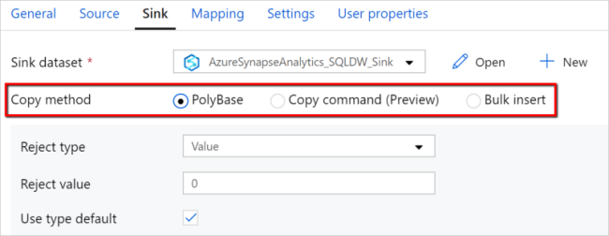
Ingest – Synapse Pipelines
Un-check USE TYPE DEFAULT, it is not a best practice.
Land data in ADLS Gen2, then ingest using Polybase / COPY.
This means you can re-ingest the same data set without having to repeat extracts, and better demonstrate ingestion performance.
Notes:
https://docs.microsoft.com/en-us/azure/data-factory/connector-azure-sql-data-warehouse#polybase-troubleshooting <- a good resource to share out as well
Lino 68

Slide 95
Ingest and Store – Loading staging tables
Indexing
Use Heap tables
Speed load performance by staging data in heap tables and temporary tables prior to running transformations.
Only load to a CCI table if the test requires a load to a single table, then complex end-user queries against that table.
as
Notes:
What should you use for the fastest loading of staging tables?
A heap table. If you are loading data only to stage it before running more transformations, loading the table to heap table is much faster than loading the data to a clustered columnstore table.
A temporary table. Loading data to a temporary table loads faster than loading a table to permanent storage.

Slide 96
Ingest and Store – Loading staging tables
Distribution
Use Round Robin Distribution for:
Potentially useful tables created from raw input.
Temporary staging tables used in data preparation.
Other distribution considerations:
Never load to a REPLICATED table
Load to a ROUND_ROBIN table if the test is ONLY raw ingestion performance, or if the table is very small
Load to a HASH table if the test is a pipeline with subsequent transformations using the loaded table
Notes:
How should you configure table distribution for tables created from the raw input that might be useful, or tables used for staging?
Consider round-robin distribution.
A round-robin distributed table distributes table rows evenly across all distributions. The assignment of rows to distributions is random. Unlike hash-distributed tables, rows with equal values are not guaranteed to be assigned to the same distribution.
As a result, the system sometimes needs to invoke a data movement operation to better organize your data before it can resolve a query. This extra step can slow down your queries. For example, joining a round-robin table usually requires reshuffling the rows, which is a performance hit.
Consider using the round-robin distribution for your table in the following scenarios:
When getting started as a simple starting point since it is the default
If there is no obvious joining key
If there is not good candidate column for hash distributing the table
If the table does not share a common join key with other tables
If the join is less significant than other joins in the query
When the table is a temporary staging table

Slide 97
Ingest – Scaling to shorten duration
Ingestion duration is correlated with the number of DWU’s allocated to the SQL Pool.
For every doubling of the DWU’s you halve the ingestion time.
2d = t/2
d: DWU
T: ingestion time
Only applies from DWU500c – DWU30000c

Slide 98
Pop Quiz
True or False: Both COPY command AND Polybase require CONTROL permission
TRUE
FALSE

Slide 99
Pop Quiz
True or False: Both COPY command AND Polybase require CONTROL permissions
TRUE
FALSE
Notes:
FALSE – only Polybase requires CONTROL permission

Slide 100
Modern Data Warehouse
INGEST
PREPARE
TRANSFORM & ENRICH
SERVE
VISUALIZE
STORE

Slide 101









Modern Data Warehouse
INGEST
PREPARE
TRANSFORM & ENRICH
SERVE
VISUALIZE
AZURE SYNAPSE ANALYTICS
Synapse SQL (Provisioned)
Synapse Pipeline
Synapse SQL (Provisioned)
Data Sources
Synapse SQL (Serverless)
Synapse Pipeline
Power BI
OR
OR
Synapse Pipelines
Synapse SQL (Serverless)
Synapse Spark
Synapse Spark
Synapse SQL (Serverless)
STORE
ADLS Gen 2
Storage Account
Data Lake

Slide 102
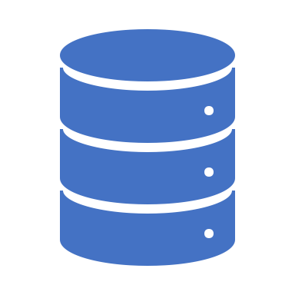
Introduction to SQL Serverless

Slide 103





Serverless SQL Pool
Overview
An interactive query service that provides T-SQL queries over high scale data in Azure Storage.
Benefits
Pay-per-query with serverless model
Query data in-place on the data lake with T-SQL (no ETL)
Supports various file formats (Parquet, CSV, JSON)
Integrates with Databricks, HDInsight, PowerBI, and the shared Synapse metastore
Power BI
Curate and transform data
SQL On Demand Query
Azure Data Studio
Sync table definitions
Read and write
data files
SSMS
Read and write
data files
10
01
Azure Storage

Slide 104
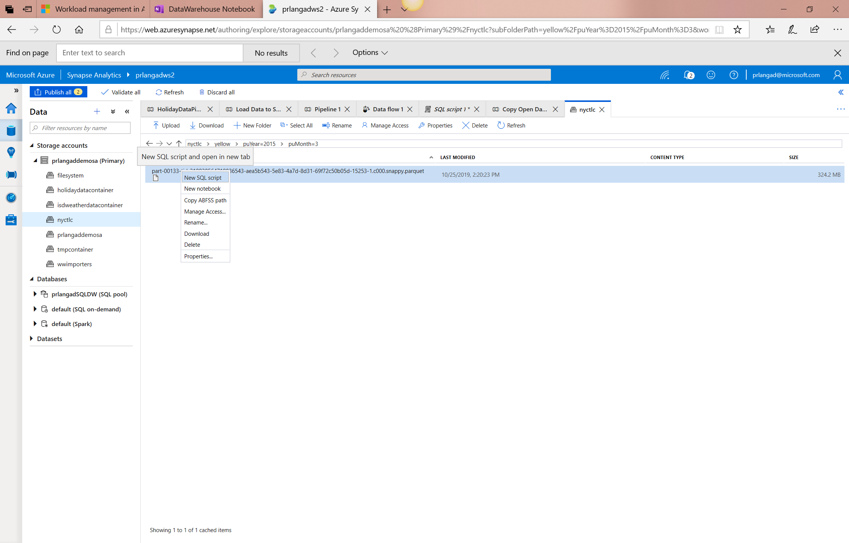
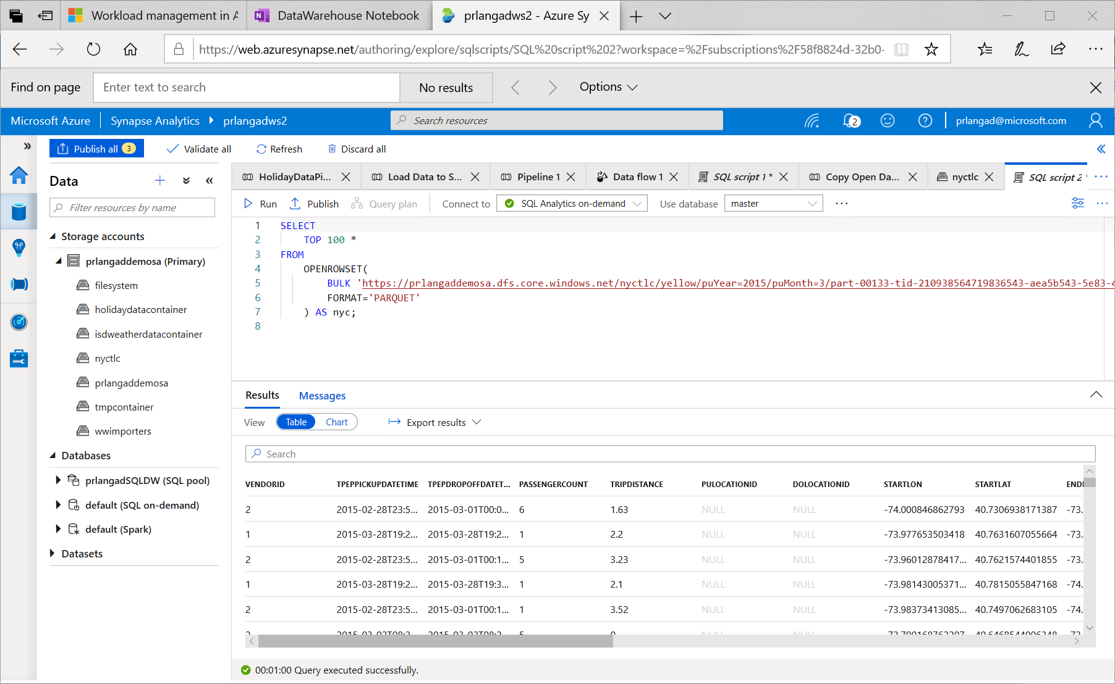
Serverless SQL – Querying on storage

Slide 105
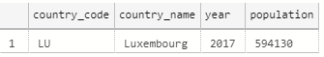
Serverless SQL – Querying CSV File
Overview
Uses OPENROWSET function to access data
Benefits
Ability to read CSV File with
- no header row, Windows style new line
- no header row, Unix-style new line
- header row, Unix-style new line
- header row, Unix-style new line, quoted
- header row, Unix-style new line, escape
- header row, Unix-style new line, tab-delimited
- without specifying all columns
SELECT *
FROM OPENROWSET(
BULK 'https://XXX.blob.core.windows.net/csv/population/population.csv',
FORMAT = 'CSV',
FIELDTERMINATOR =',',
ROWTERMINATOR = '\n'
)
WITH (
[country_code] VARCHAR (5) COLLATE Latin1_General_BIN2,
[country_name] VARCHAR (100) COLLATE Latin1_General_BIN2,
[year] smallint,
[population] bigint
) AS [r]
WHERE
country_name = 'Luxembourg'
AND year = 2017

Slide 106
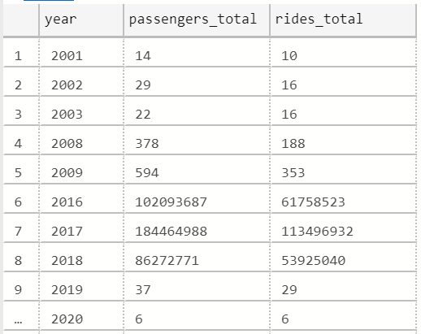
Serverless SQL – Querying folders
Overview
Uses OPENROWSET function to access data from
multiple files or folders
Benefits
Offers reading multiple files/folders through usage of wildcards
Offers reading specific file/folder
Supports use of multiple wildcards
SELECT YEAR(pickup_datetime) as [year], SUM(passenger_count) AS passengers_total, COUNT(*) AS [rides_total]
FROM OPENROWSET(
BULK 'https://XXX.blob.core.windows.net/csv/taxi/*.*’,
FORMAT = 'CSV’
, FIRSTROW = 2 )
WITH (
vendor_id VARCHAR(100) COLLATE Latin1_General_BIN2,
pickup_datetime DATETIME2,
dropoff_datetime DATETIME2,
passenger_count INT,
trip_distance FLOAT,
rate_code INT,
store_and_fwd_flag VARCHAR(100) COLLATE Latin1_General_BIN2,
pickup_location_id INT,
dropoff_location_id INT,
payment_type INT,
fare_amount FLOAT,
extra FLOAT, mta_tax FLOAT,
tip_amount FLOAT,
tolls_amount FLOAT,
improvement_surcharge FLOAT,
total_amount FLOAT
) AS nyc
GROUP BY YEAR(pickup_datetime)
ORDER BY YEAR(pickup_datetime)

Slide 107
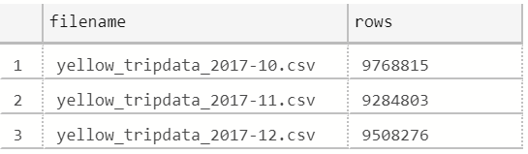
Serverless SQL – Querying specific files
Overview
filename – Provides file name that originates row result
filepath – Provides full path when no parameter is passed or part of path when parameter is passed that originates result
Benefits
Provides source name/path of file/folder for row result set
Example of filename function
SELECT
r.filename() AS [filename]
,COUNT_BIG(*) AS [rows]
FROM OPENROWSET(
BULK 'https://XXX.blob.core.windows.net/csv/taxi/yellow_tripdata_2017-1*.csv’,
FORMAT = 'CSV',
FIRSTROW = 2
)
WITH (
vendor_id INT,
pickup_datetime DATETIME2,
dropoff_datetime DATETIME2,
passenger_count SMALLINT,
trip_distance FLOAT,
<…columns>
) AS [r]
GROUP BY r.filename()
ORDER BY [filename]

Slide 108
Serverless SQL – Querying specific files
Example of filepath function
SELECT
r.filepath() AS filepath
,r.filepath(1) AS [year]
,r.filepath(2) AS [month]
,COUNT_BIG(*) AS [rows]
FROM OPENROWSET(
BULK 'https://XXX.blob.core.windows.net/csv/taxi/yellow_tripdata_*-*.csv’,
FORMAT = 'CSV',
FIRSTROW = 2 )
WITH (
vendor_id INT,
pickup_datetime DATETIME2,
dropoff_datetime DATETIME2,
passenger_count SMALLINT,
trip_distance FLOAT,
<… columns>
) AS [r]
WHERE r.filepath(1) IN ('2017’)
AND r.filepath(2) IN ('10', '11', '12’)
GROUP BY r.filepath() ,r.filepath(1) ,r.filepath(2)
ORDER BY filepath
filepath | year | month | rows
https://XXX.blob.core.windows.net/csv/taxi/yellow_tripdata_2017-10.csv | 2017 | 10 | 9768815
https://XXX.blob.core.windows.net/csv/taxi/yellow_tripdata_2017-11.csv | 2017 | 11 | 9284803
https://XXX.blob.core.windows.net/csv/taxi/yellow_tripdata_2017-12.csv | 2017 | 12 | 9508276

Slide 109
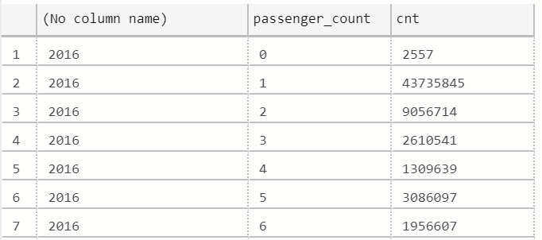
Serverless SQL – Querying Parquet files
Overview
Uses OPENROWSET function to access data
Benefits
Ability to specify column names of interest
Offers auto reading of column names and data types
Provides target specific partitions using filepath function
SELECT
YEAR(pickup_datetime),
passenger_count,
COUNT(*) AS cnt
FROM
OPENROWSET(
BULK 'https://XXX.blob.core.windows.net/parquet/taxi/*/*/*',
FORMAT='PARQUET'
) WITH (
pickup_datetime DATETIME2,
passenger_count INT
) AS nyc
GROUP BY
passenger_count,
YEAR(pickup_datetime)
ORDER BY
YEAR(pickup_datetime),
passenger_count

Slide 110
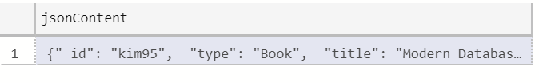
Serverless SQL – Querying JSON files
Overview
Read JSON files and provides data in tabular format
Benefits
Supports OPENJSON, JSON_VALUE and JSON_QUERY functions
SELECT *
FROM
OPENROWSET(
BULK 'https://XXX.blob.core.windows.net/json/books/book1.json’,
FORMAT='CSV',
FIELDTERMINATOR ='0x0b',
FIELDQUOTE = '0x0b',
ROWTERMINATOR = '0x0b'
)
WITH (
jsonContent varchar(8000)
) AS [r]

Slide 111
Serverless SQL – Querying JSON files
Example of JSON_VALUE function
Example of JSON_QUERY function
SELECT
JSON_VALUE(jsonContent, '$.title') AS title,
JSON_VALUE(jsonContent, '$.publisher') as publisher,
jsonContent
FROM
OPENROWSET(
BULK 'https://XXX.blob.core.windows.net/json/books/*.json',
FORMAT='CSV',
FIELDTERMINATOR ='0x0b',
FIELDQUOTE = '0x0b',
ROWTERMINATOR = '0x0b'
)
WITH (
jsonContent varchar(8000)
) AS [r]
WHERE
JSON_VALUE(jsonContent, '$.title') = 'Probabilistic and Statistical Methods in Cryptology, An Introduction by Selected Topics'
SELECT
JSON_QUERY(jsonContent, '$.authors') AS authors,
jsonContent
FROM
OPENROWSET(
BULK 'https://XXX.blob.core.windows.net/json/books/*.json',
FORMAT='CSV',
FIELDTERMINATOR ='0x0b',
FIELDQUOTE = '0x0b',
ROWTERMINATOR = '0x0b'
)
WITH (
jsonContent varchar(8000)
) AS [r]
WHERE
JSON_VALUE(jsonContent, '$.title') = 'Probabilistic and Statistical Methods in Cryptology, An Introduction by Selected Topics'

